Slide 1
Introduction to Compiler Design
Chapter-2
Lexical Analysis
CSE DEPT.
AMRITA SCHOOL OF ENGG.

Slide 2

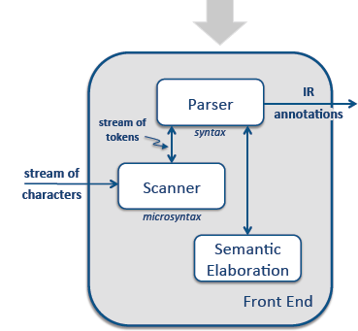
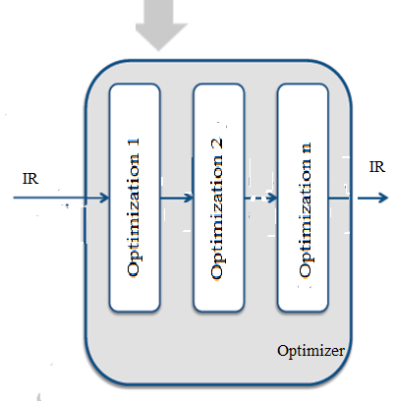
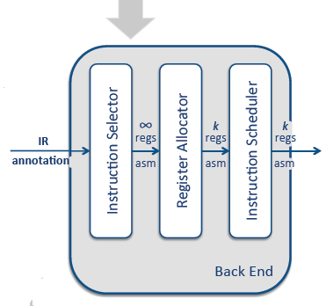
Overview of Translation
Even Semester 2017-18
Nalinadevi Kadiresan

Slide 3

Introduction
Scanning is the first stage of a three-part process that the compiler uses to understand the input program. ​
The scanner, or lexical analyzer, reads a stream of characters and produces a stream of words. ​
It aggregates characters to form words and applies a set of rules to determine whether or not each word is legal in the source language. ​
If the word is valid, the scanner assigns it a syntactic category, or part of speech.​
The scanner is the only pass in the compiler that manipulates every character of the input program.​
This is an aggregation and classification process
Odd Semester 2022-2023
Dr. G.JeyaKumar

Slide 4

What is Microsyntax?
To accomplish this aggregation and classification, the scanner applies a set of rules that describe the lexical structure of the input programming language, called as microsyntax.
The microsyntax of a programming language specifies how to group characters into words and, conversely, how to separate words that run together.
Odd Semester 2022-2023
Dr. G.JeyaKumar

Slide 5
What is Microsyntax?
Microsyntax – in Programming language
(Almost similar to English’s microsyntax)
  Characters are aggregated into words.
  Blanks and punctuation marks terminate a word.
Example:
Algol defines identifier as a single alphabetic character followed by zero or more alphanumeric characters.
The identifier ends with the first nonalphanumeric character.
To Note - Set of valid words is specified by rules rather than by enumeration in a dictionary.
Microsyntax – in English language
Adjacent alphabetic letters are grouped together, left to right, to form a word.
A blank space terminates a word.
The word-building algorithm can determine its validity with a dictionary lookup.
The compiler writer must start the work from formulating the specification of the microsyntax for the source language.
Odd Semester 2022-2023
Dr. G.JeyaKumar

Slide 6
Microsyntax specification as Token, Lexeme and Pattern
Token
  It is basically a sequence of characters that are treated as a unit as it cannot be further broken down.
  Tokens in programming languages like C language-
    keywords (int, char, float, const, goto, continue, etc.)
    identifiers (user-defined names),
    operators (+, -, *, /),
    delimiters/punctuators like comma (,), semicolon(;), braces ({ }), etc. ,
    strings.
Odd Semester 2022-23
Nalinadevi Kadiresan

Slide 7
Microsyntax specification as Token, Lexeme and Pattern
Lexeme
  It is a sequence of characters in the source code that are matched by given predefined language rules for every lexeme to be specified as a valid token.
Pattern
  It specifies a set of rules that a scanner follows to create a token.
Even Semester 2017-18
Nalinadevi Kadiresan

Slide 8
Microsyntax specification as Token, Lexeme and Pattern
For a keyword to be identified as a valid token, the pattern is the sequence of characters that make the keyword.
  Example: ‘main’ is a lexme, its token is KEYWORD, and its pattern is the regular expression m.a.i.n
For identifier to be identified as a valid token, the pattern is the predefined rules that it must start with alphabet, followed by alphabet or a digit.
  Example: ‘num’ is a lexme, its token is IDENTIFIER, and its pattern is the regular expression is (a-z)(a-z|0-9|_)*
Even Semester 2017-18
Nalinadevi Kadiresan

Slide 9
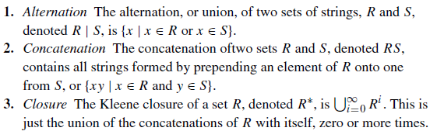
What is a Regular Expression?
To work with regular expressions in a rigorous way, we must define them more formally.
An RE describes a set of strings over the characters contained in some alphabet, Σ augmented with a character ε that represents the empty string.
We call the set of strings a language.
For a given RE, r, we denote the language that it specifies as L(r).
An RE is built up from three basic operations:
Odd Semester 2022-23
Dr.G. Jeyakumar

Slide 10
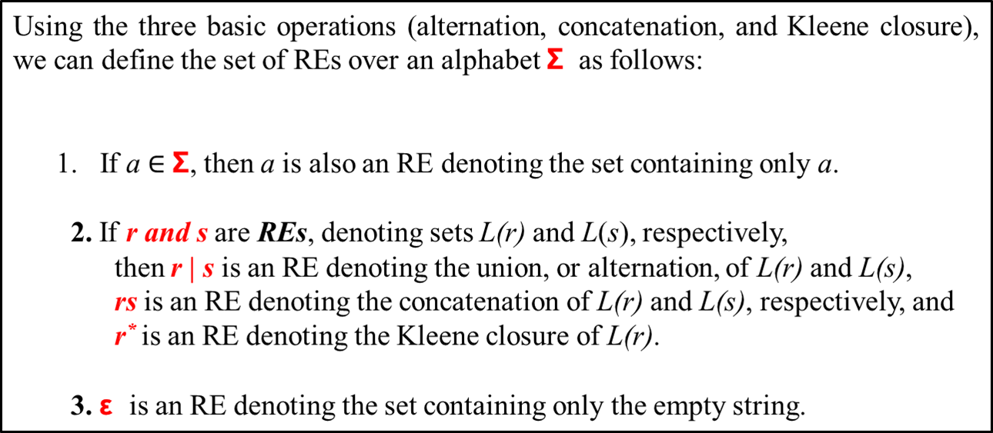
What is a Regular Expression?
Finite closure - R^{i} – denotes 1 to i occurrence of R. Example R³ = (R | RR | RRR)
Positive closure – R⁺ denotes RR* - that is one or more occurrence of R.
Odd Semester 2022-23
Dr.G. Jeyakumar

Slide 11

Writing Lexer Specification
Some examples of REs from programming languages
identifiers - an alphabetic character followed by zero or more alphanumeric characters,
The RE is ([A. . . Z] | [a. . . z]) ([A. . . Z] | [a. . . z] | [0. . . 9])*
If the length of the identifier is restricted to maximum of 6 character,
The RE is ([A. . . Z] | [a. . . z]) ([A. . . Z] | [a. . . z] | [0. . . 9])⁵
(2) unsigned integer - either zero or a nonzero digit followed by zero or more digits
The RE is 0 | [1. . . 9] [0. . . 9]*
(3) Unsigned real numbers
The RE is (0 | [1. . . 9] [0. . . 9]*) (ε | . [0. . . 9]*)
The first part is just the RE for an integer. The rest generates either the empty string or a decimal point followed by zero or more digits.
(4) Quoted character strings
Using complement operator, the RE for a character string is “ (ˆ”)* ”.
(5) Comments
The RE is // (ˆ\n)* \n,

Slide 12
Writing Lexer Specification
Multiline comments in c, c++, and Java begin with the delimiter /* and end with */.
If we could disallow * in a comment, the RE is simple : simple: /* (ˆ*)**/.
Eg. /* This program is for Matrix Multiplication */
If we allow * in the comments sentence the RE is complex /* ( ˆ* | *⁺ ˆ/ ) */.
Eg. /* The * used in program is to print * triangle */

Slide 13
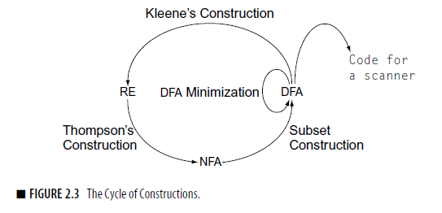
Regular Expression to Finite Automata
The goal with finite automata is to automate the derivation of executable scanners from a collection of REs.
We will discuss the constructions that transform an RE into an FA that is suitable for direct implementation and an algorithm that derives an RE for the language accepted by an FA.
Figure 2.3 shows the relationship between all of these constructions.
Will discuss deterministic FAs, or DFAs, and nondeterministic FAs, or NFAs.
Construction of a DFA from an RE in three steps.
(1) Thompson’s construction - derives an NFA from an RE.
(2) The subset construction - builds a DFA that simulates an NFA.
(3) Hopcroft’s algorithm - minimizes the DFA.
Kleene’s construction derives an RE from a DFA.

Slide 14
What is a NFA?
Nondeterministic FA: an FA that allows transitions on the empty string, ε and states that have multiple transitions on the same character.
NFA also has five states same as DFA, but with different transition function, as shown follows:
    δ: Q x ∑ →2^{Q}
where,
    Q: finite set of states
    ∑: finite set of the input symbol
    q0: initial state
    F: final state
    δ: Transition function
Even Semester 2017-18
Nalinadevi Kadiresan

Slide 15
What is a DFA?
Deterministic FA: an FA where the transition function is single-valued. DFAs do not allow Ԑ-transitions.
A DFA is a collection of 5-tuples same as we described in the definition of FA.
    Q: finite set of states
    ∑: finite set of the input symbol
    q0: initial state
    F: final state
    δ: Transition function
Transition function can be defined as: δ: Q x ∑→Q
Even Semester 2017-18
Nalinadevi Kadiresan

Slide 16
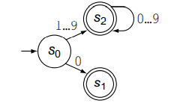
Recognizer vs Tokenizer
Recognizer: A state transition diagram is a typical recognizer which accepts or rejects a sequence of alphabets.
  The following state transition diagram can identify 113 as a unsigned integer.
Tokenizer: A lexer or a tokenizer which takes as input a stream of characters and splits them into tokens using the state transition diagram. Tokens are described as <token name, token value>.
  The following state transition diagram has multiple final states indicating the token names like IF, ID, NUM, REAL, WHITESPACE.
Even Semester 2017-18
Nalinadevi Kadiresan

Slide 17
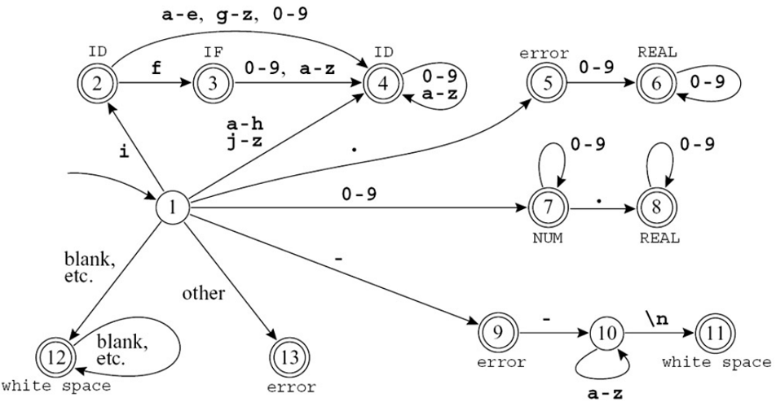
Recognizer vs Tokenizer
Even Semester 2017-18
Nalinadevi Kadiresan

Slide 18
Writing Lexer Specification -Disambiguation Rules
Lexer or scanner or tokenizer aims to spilt the input to match the longest path in the given state transition diagram based order of occurrence of rules.
Hence,
  The rule that match the path is called as the longest match rule.
  The lexical analyzer also follows rule priority.
Even Semester 2017-18
Nalinadevi Kadiresan

Slide 19
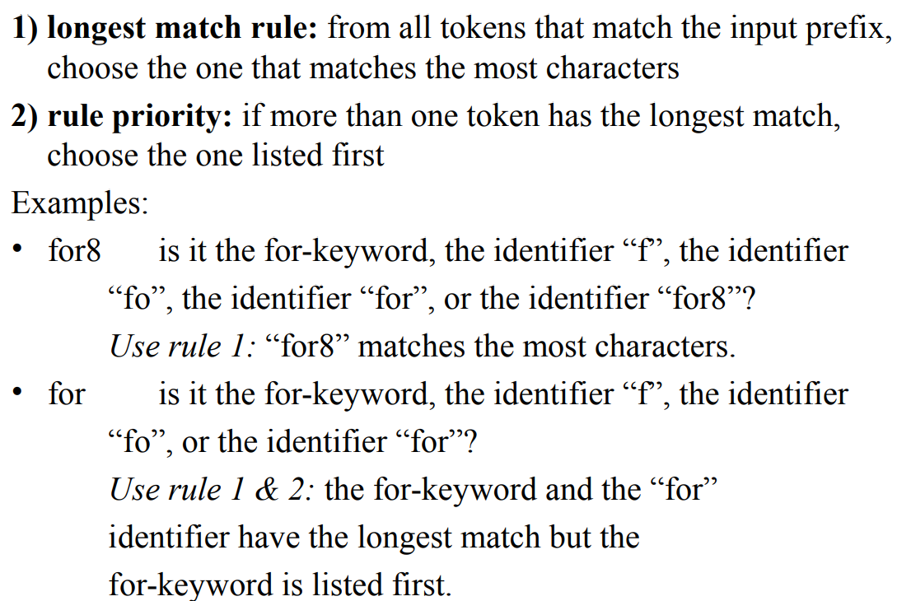
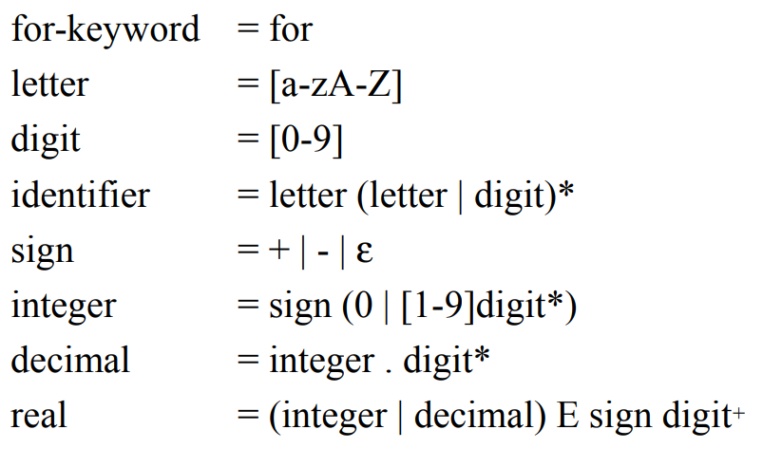
Writing Lexer Specification -Disambiguation Rules
Consider the rules:
Even Semester 2017-18
Nalinadevi Kadiresan

